Slide 1
People matter survey 2024 results
Using and understanding your PDF and Excel result reports

Slide 2
Introduction
Your People matter survey results are available as static reports in PDF and Excel, as well as online interactive dashboards.
What information your organisation gets, and the types of reports is on our website.
You have secure access to your results from two places:
Qualtrics for interactive dashboards.
Online report server for PDF and Excel static reports.
This presentation will help you to use and understand your PDF, Word and Excel result reports.
A guide to using your People matter survey interactive dashboards in available on our website.

Slide 3
What results you have access to

Slide 4
Your People matter survey 2024 reports overview
Report | PDF Format | Excel format
Executive summary | Yes | -
Organisation-Level benchmark | Yes | Yes
Employee group (hierarchy)* | Yes | Yes
Demographic matrix** | - | Yes
*Employee group reports are only available if a hierarchy was included in the survey.
**Demographic matrix file is only available if 30 or more survey responses are received.
Response threshold is 10 responses to receive all other reports.

Slide 5
Report types
PDF
Use these to distribute results throughout your organisation. We recommend providing the organisation level benchmark report and the relevant employee group report to each manager to assist them to discuss the People matter survey results with their teams.
Excel
Use these data files for further analysis using results for all response options and side by side comparison of demographic groups (30 or more responses required) or employee groups (hierarchy required).
Accessible Word
Word reports will not be generated as standard for this year's survey.
If you need your PDF reports in an accessible format, please email us at people.matter@vpsc.vic.gov.au

Slide 6
Your People matter survey 2024 PDF reports
Executive summary
Organisation-level results across a range of indicators including employee engagement, job satisfaction, wellbeing and work-related stress.
Includes:
Overview
Scorecards
Negative behaviour
Key differences
People outcomes
Heatmaps
Organisation report
Organisation-level results across a range of indicators including employee engagement, job satisfaction, wellbeing and work-related stress.
Benchmarked survey results against similar organisations and public sector.
Employee group (hierarchy) report
Benchmarked survey results for groups, divisions or branches within each organisation.

Slide 7
Your People matter survey 2024 Excel reports
Organisation Benchmark
Your organisation’s results the same as your PDF organisation report.
Includes benchmarks and comparisons with previous years, your comparator group and public sector.
Includes your custom questions as a separate tab.
Demographic matrix
Summary of your opinion results by each demographic group, such as age, gender, cultural background.
Includes your custom questions as a separate tab.
Employee group hierarchy
Employee group-level results across a range of indicators including employee engagement, job satisfaction, wellbeing and work-related stress.
Benchmarked survey results against the parent employee group and organisation.
You can apply filters to compare your results to previous years.

Slide 8
How to access your People matter survey PDF & Excel reports

Slide 9
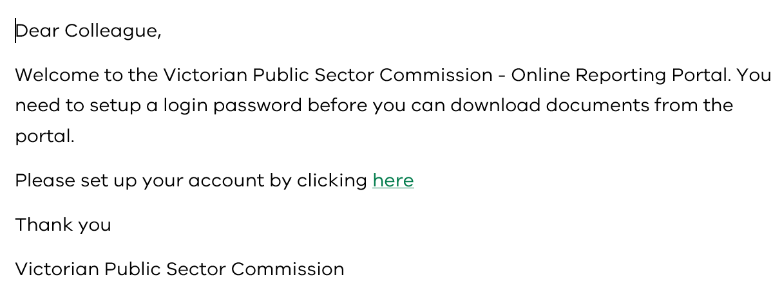
Access to your reports
New user email
You should have received an email from people.matter@vpsc.vic.gov.au with a link and login details about how you can download your reports from our secure online storage portal.
We send the email to your
Head of organisation
Head of Human Resources
Survey coordinator
Secure online storage portal sign in:
https://reports.vpsc.vic.gov.au/Online_Storage_Portal

Slide 10
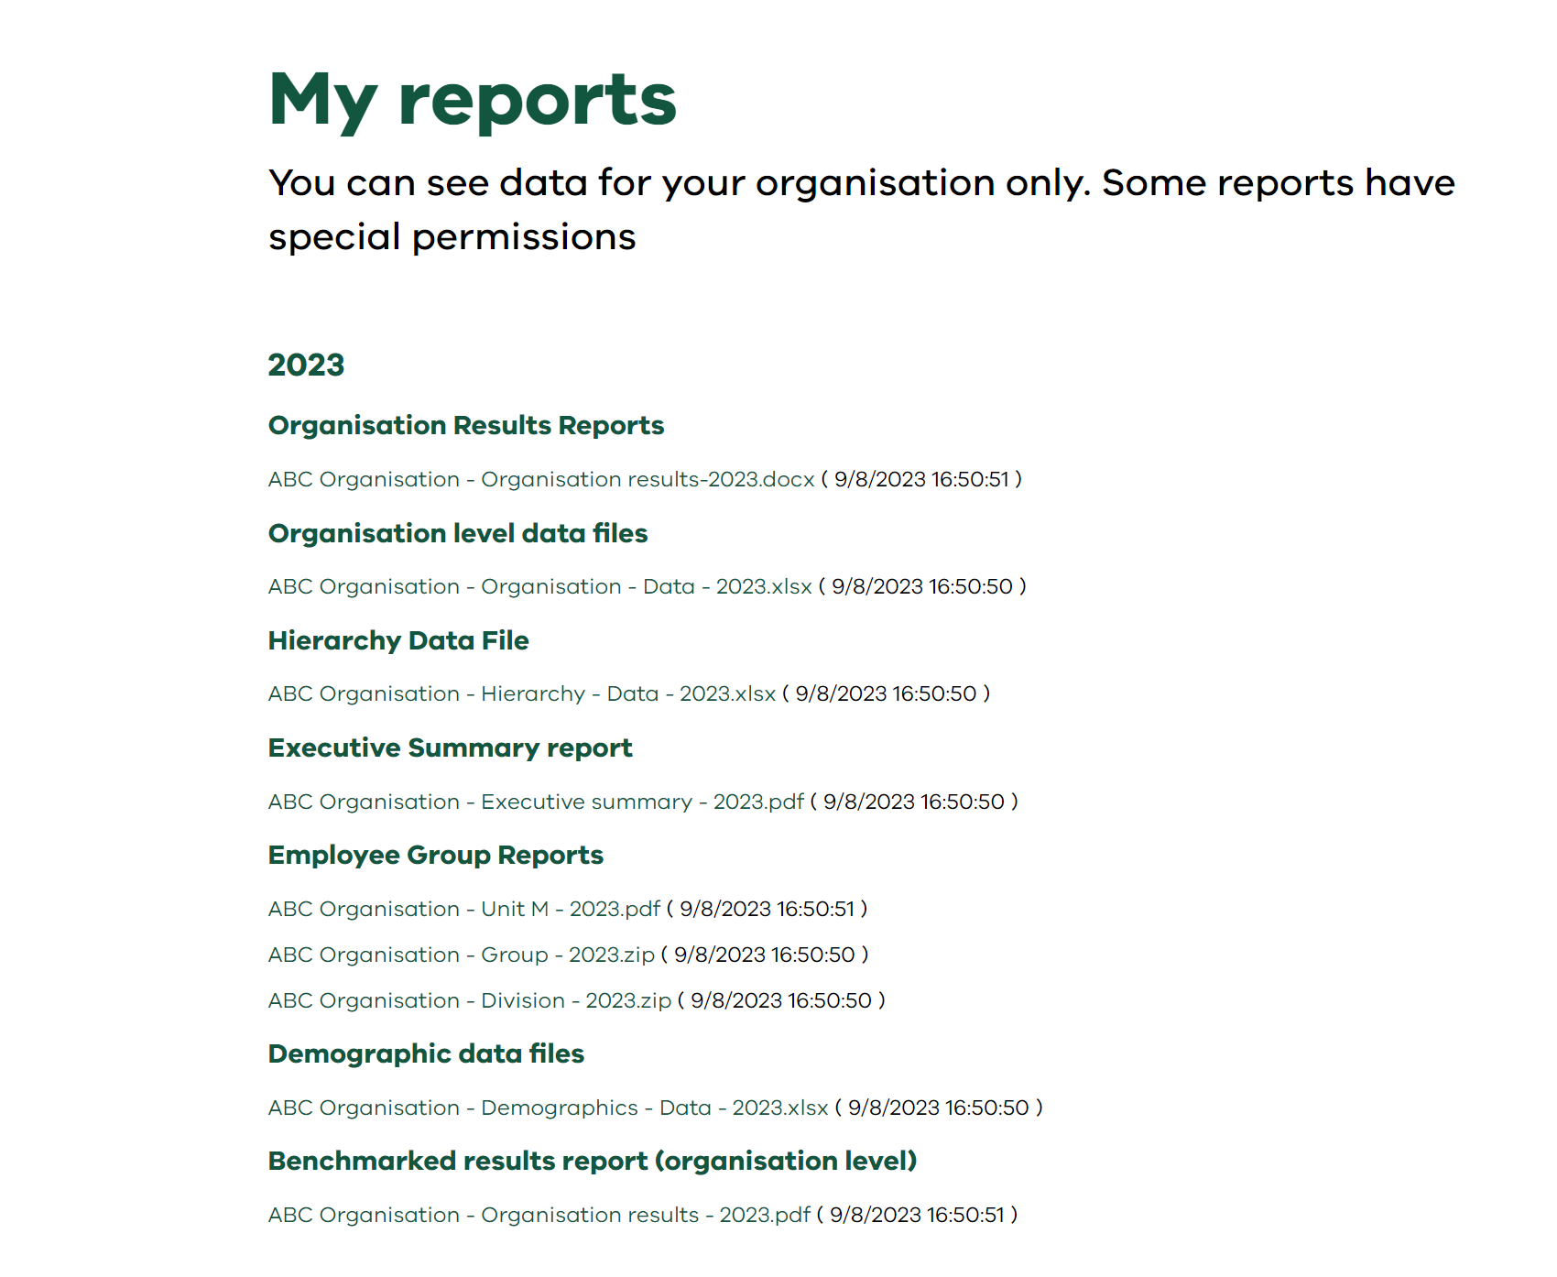
Online Storage Portal– your report screen
Your organisation’s reports are listed by files type under each heading:
Organisation Result Reports
Organisation level data files
Hierarchy Data File
Executive Summary report
Employee Group Reports
Demographic data files
Benchmarked results report (organisation level)
File extension shows each file format
Groups of 4 or more reports are in zip files for easy download.

Slide 11
How to navigate your PDF reports

Slide 12
Features of your reports
Use results across years to understand trends in your data, such as where you have shown signs of improvement or decline in different areas.
Use your results benchmarked against your comparator group to understand where your results rate:
  across similar industries for your organisation's reports.
  within different parts of your organisation for your employee group (branch, division or teams) reports.
Blank pages in your report mean less than 10 people responded to this question.
  We don’t provide data to protect the respondents.
Each slide is self-explanatory and stand alone.
Left side bar text explains the information on each slide and how to read it.
Two types of graphs:
  Bar (vertical)
  Agreement scale (horizontal)
Same colours are used throughout for charts and graphs to show your organisation's results:
    for 2024
    for 2022 to 2023 (where applicable)
    for your comparator group.

Slide 13
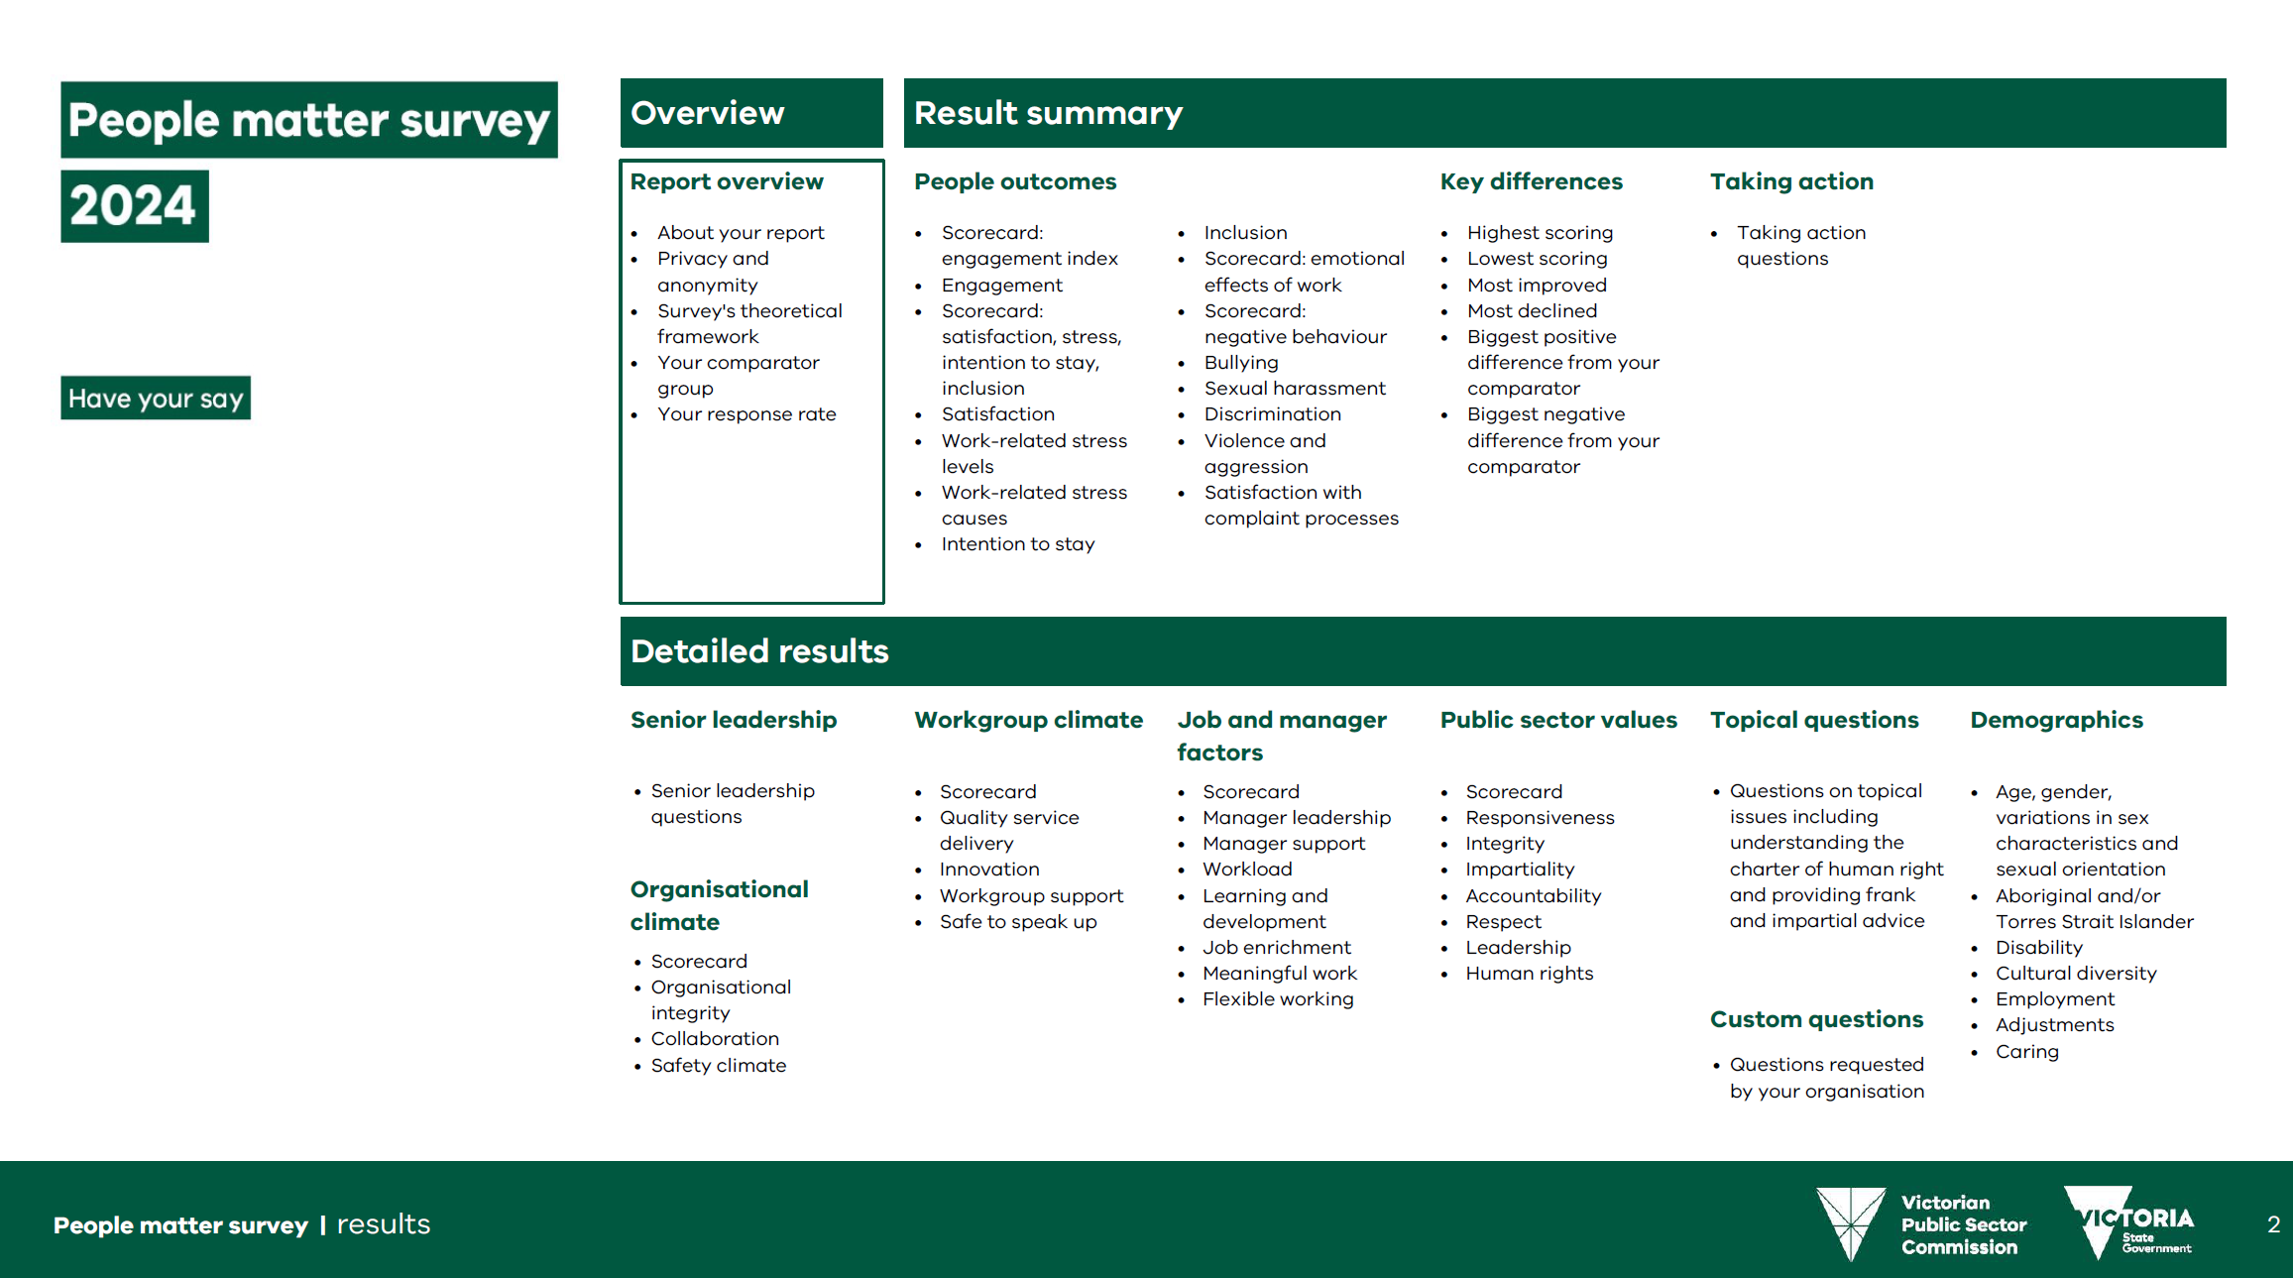
Overview of your PDF reports
Your reports are structured as:
Overview
Results summary
Detailed results
Each section of your report is shown clearly at the start by a green outline.
Green outline shows next report section

Slide 14
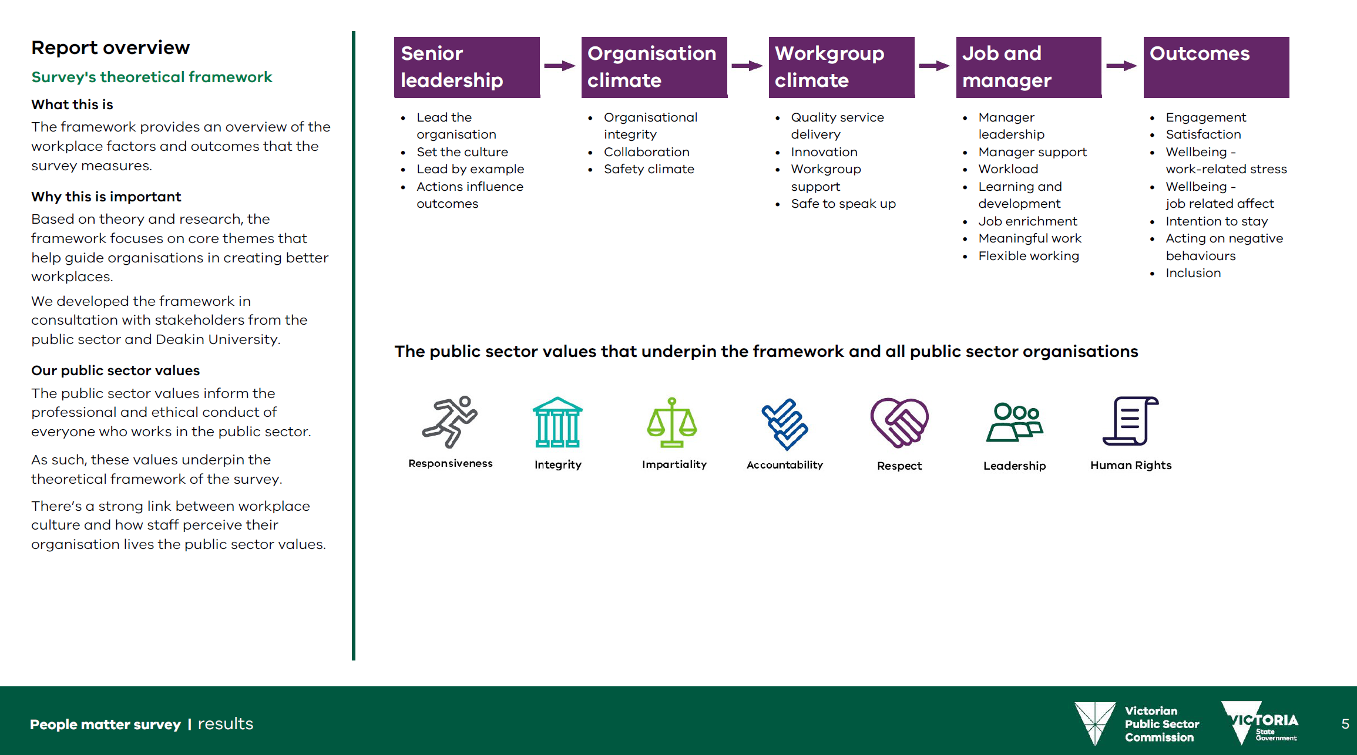
Survey theoretical framework
The framework provides an overview of the workplace factors and outcomes that the People matter survey measures.
There’s a strong link between workplace culture and how staff perceive their organisation lives the 7 public sector values.

Slide 15
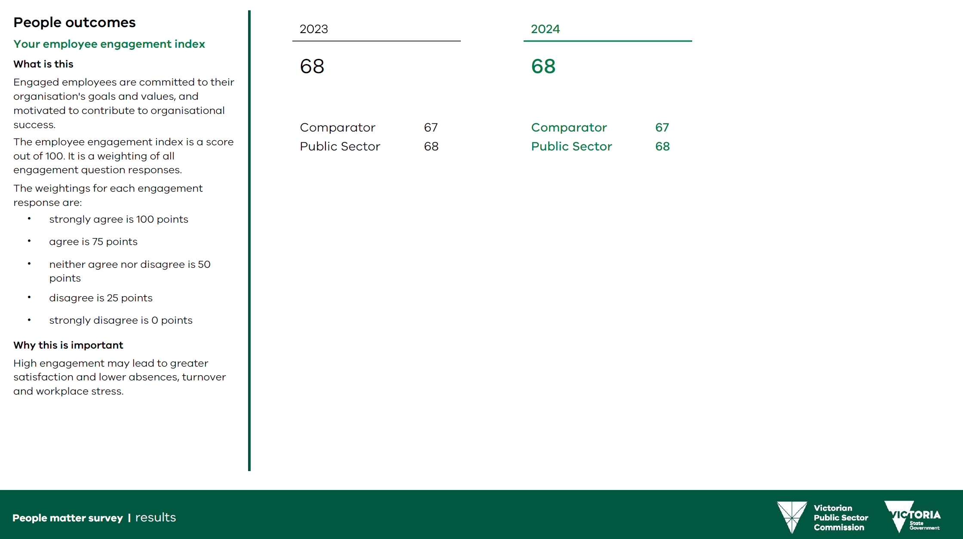
Results summary: Scorecards
Scorecard information gives you summary information about a group of questions
Text on the left side bar explains how to read each page.
Your ‘Comparator’ group is a list of similar organisations to yours.
‘Public Sector’ gives the results of all organisations that took part in the survey.
Scorecard information gives summary information for each topic area

Slide 16
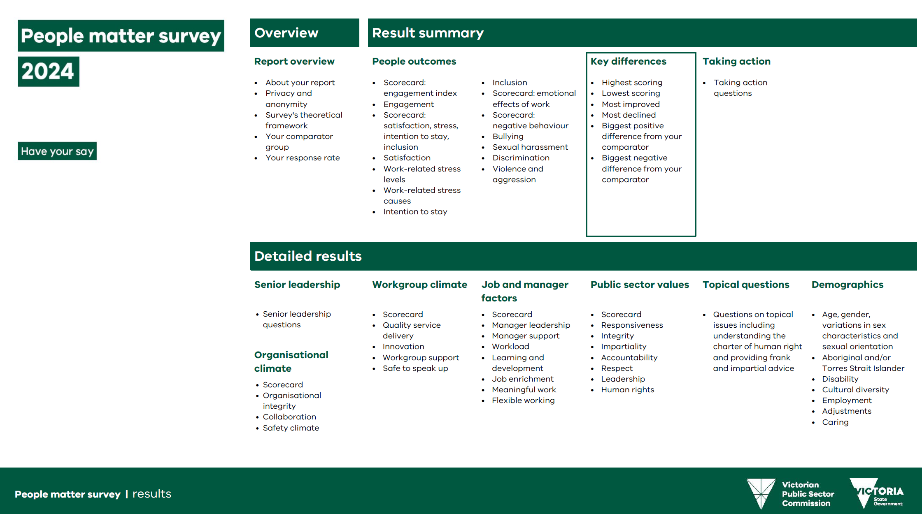
Key differences: overview
Key differences shows groups of questions for your organisation or workgroup that are:
Highest scoring
Lowest scoring
Most improved
Most declined
Biggest positive difference from comparator.
Biggest negative difference from comparator.

Slide 17
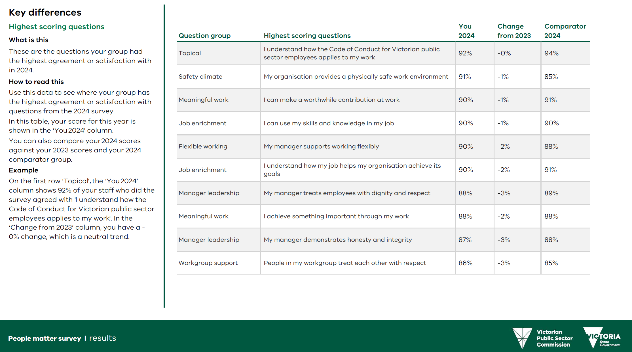
Key differences: Highest scoring questions
This page shows the questions with the overall highest agreement or satisfaction results in 2024

Slide 18
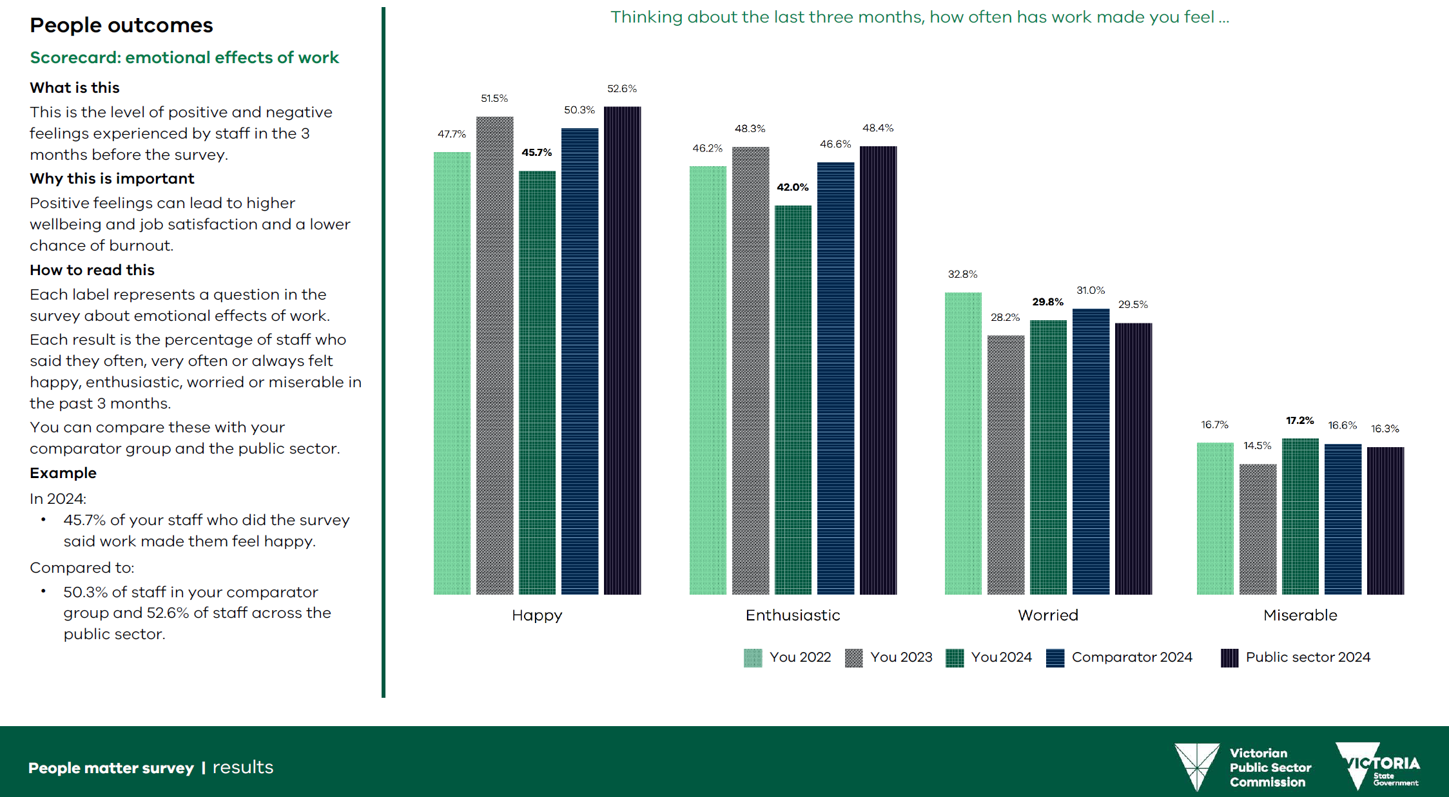
Scale of responses
Each label represents a question in the survey.
Each result is a percentage of staff who said they often, very often or always feel a certain emotion.
You can compare these with your comparator and the public sector.

Slide 19
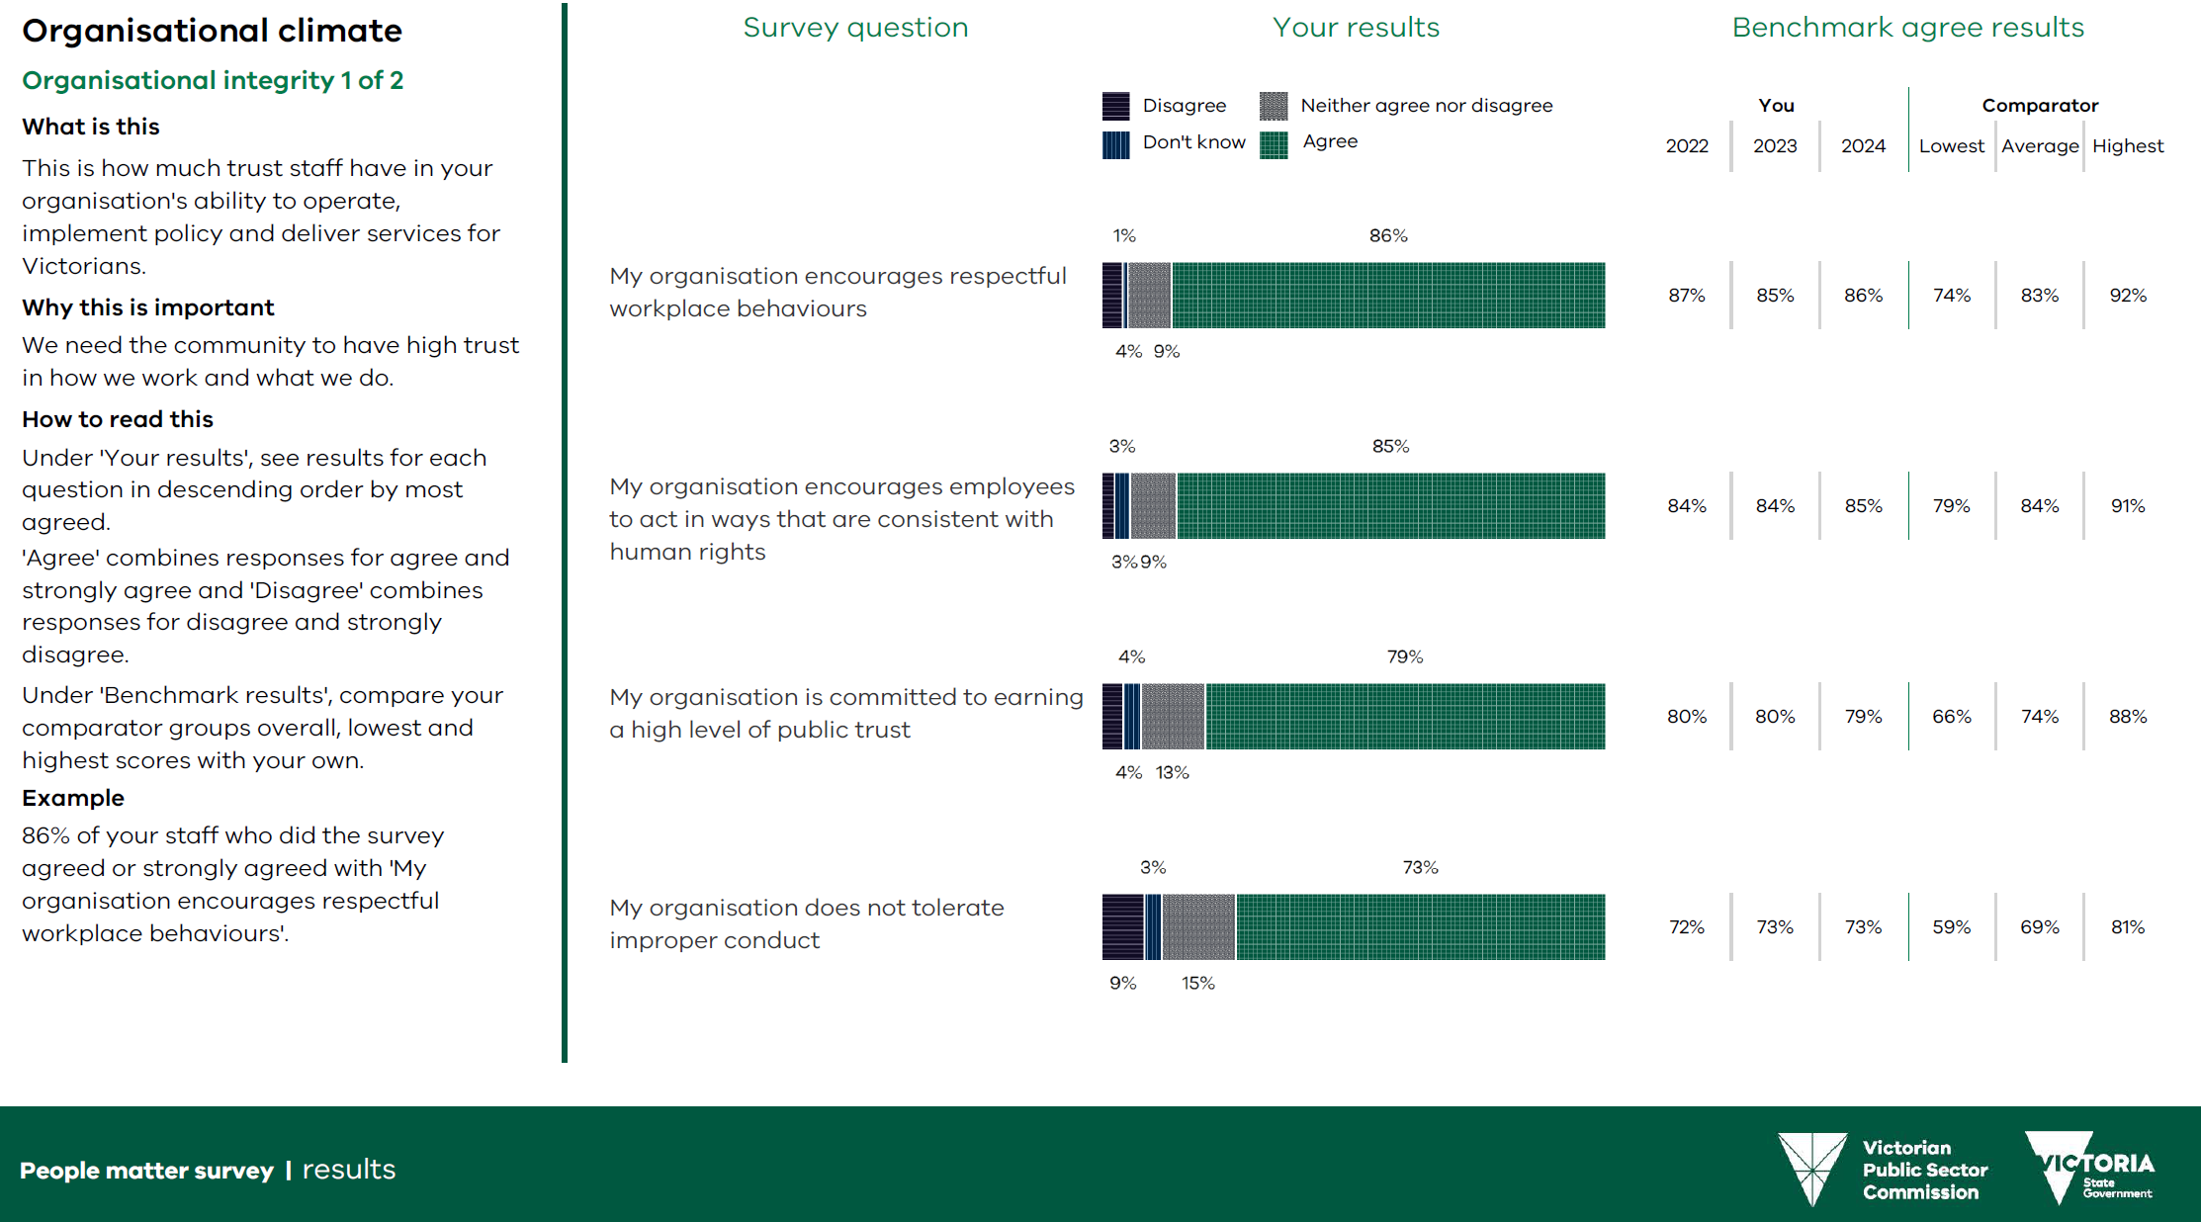
Results for specific questions
Results for years and comparator measures run left to right
Dark purple for disagree
Green for agree
Grey for neither agree nor disagree

Slide 20
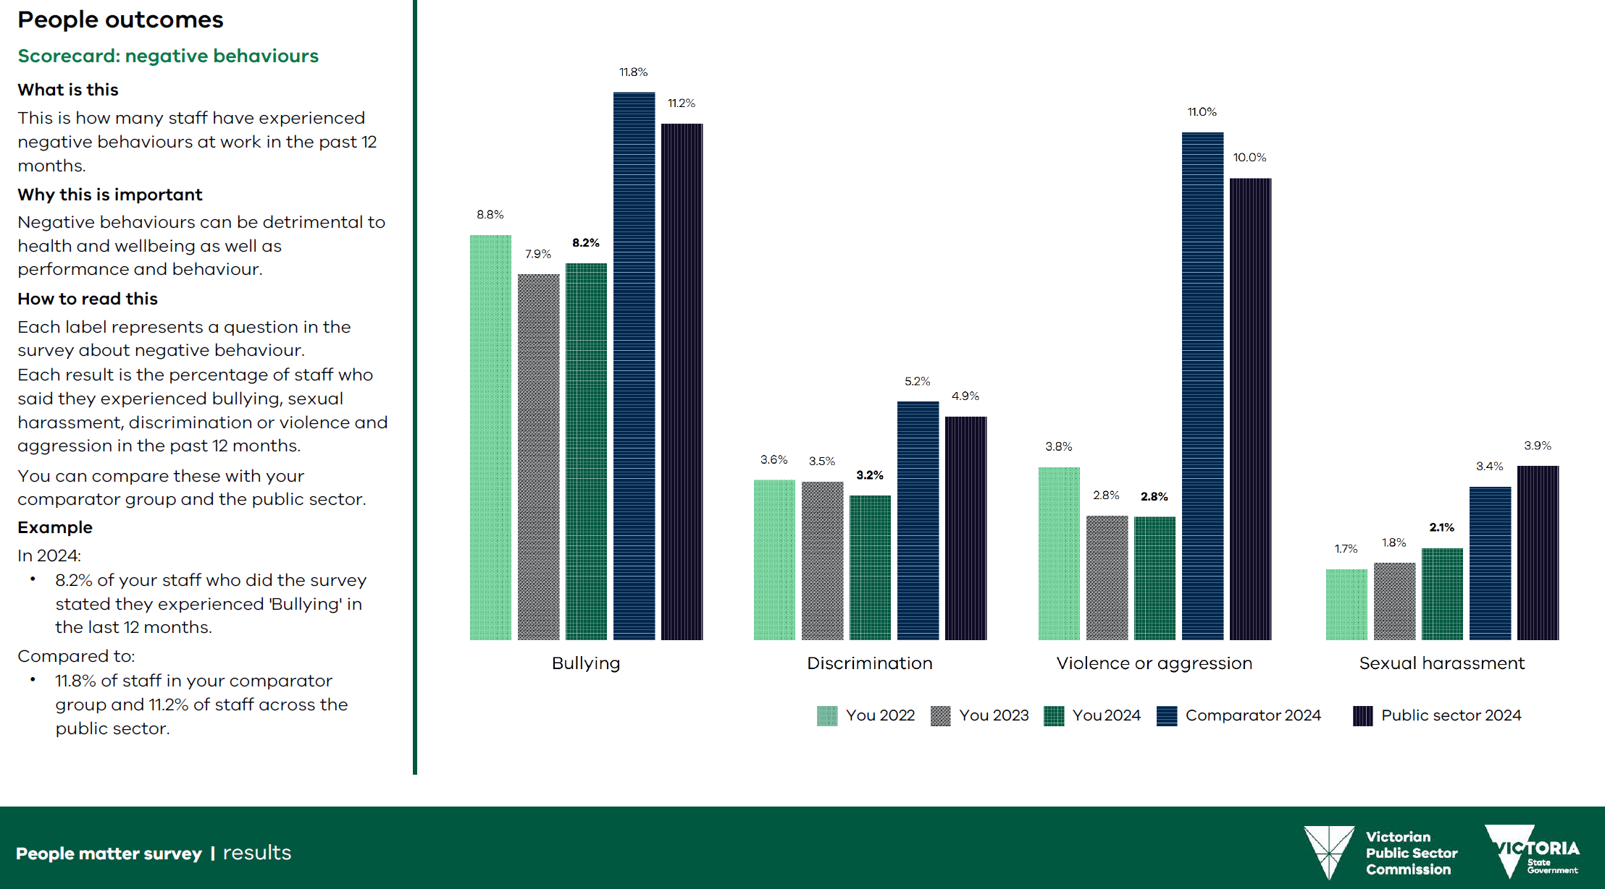
Negative behaviour results
Negative behaviour results are shown in the People outcomes section of your report.
Each results shows the percentage of staff who experienced a negative behaviour (bullying, discrimination, sexual harassment, or violence or aggression).
These results are benchmarked against your previous survey results, your comparator group and the public sector.

Slide 21
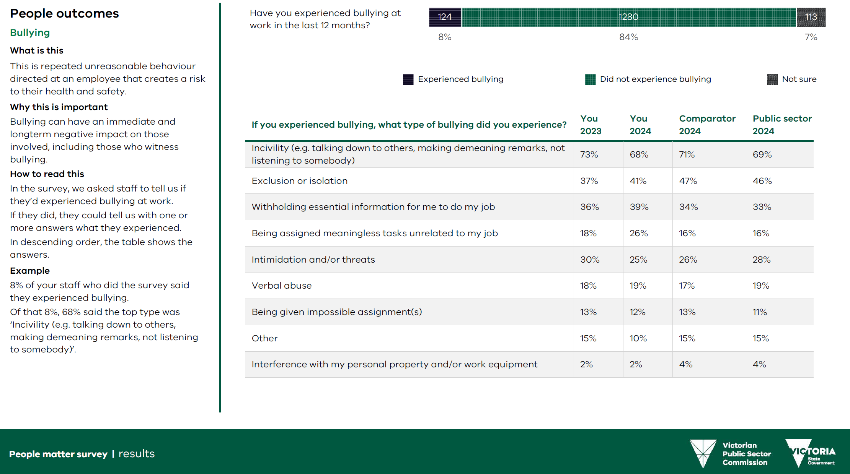
Negative behaviour results - Details
Detailed results are shown if more than 10 people experienced a negative behaviour.
The bar at the top of the page shows the overall result for the negative behaviour.
The detailed results show percentages of employees who did experience the behaviour.

Slide 22
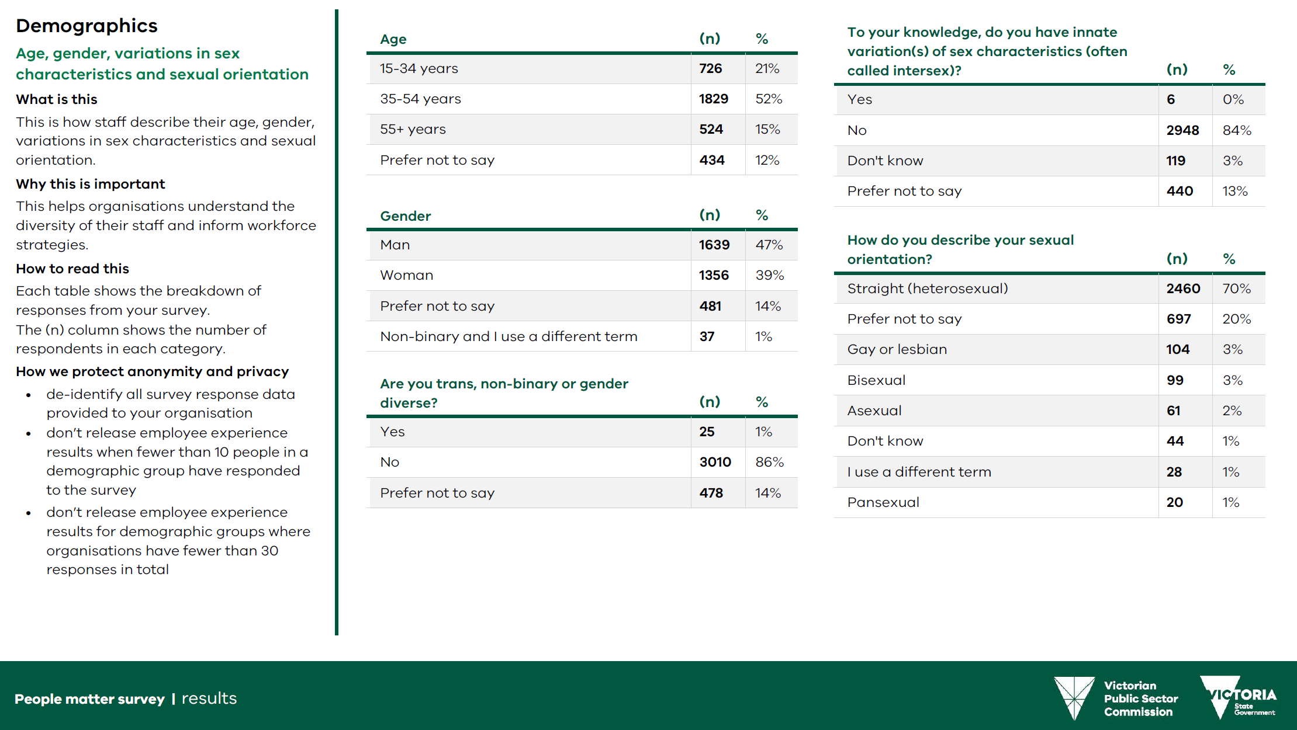
Demographic results
Demographic results are at the end of your organisation-level benchmark report.
Each table shows a breakdown of responses from your survey.
The (n) column shows the number of respondents in each category.
We use strict rules to protect the privacy and anonymity of respondents to the survey.

Slide 23
How to navigate your Excel reports

Slide 24
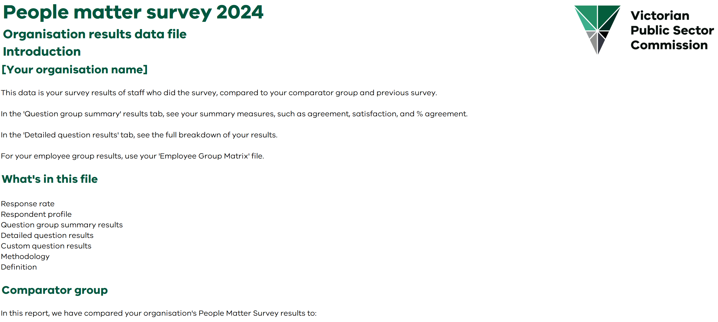
Your results in Excel format
Organisation results sample introduction page
Your results are also available as data files in Excel format.
Use the data from these files to create heatmaps and visual comparisons.
You can access three types of data files:
Organisation results
Demographic matrix
Employee group hierarchy.

Slide 25
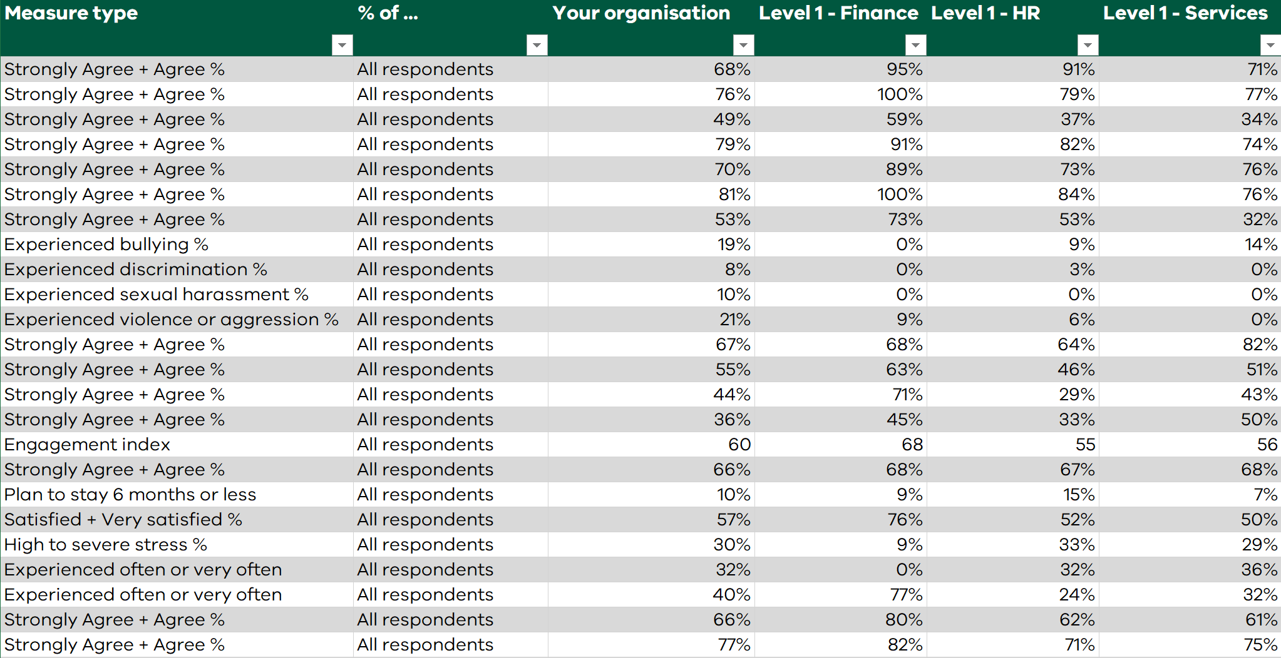
Employee group hierarchy Excel file
Employee group hierarchy file which shows:
Measure type
% of respondents
Your organisation
Your employee groups
‘Agree’ combines your staff’s responses of ‘agree’ and ‘strongly agree’.
‘Satisfied’ combines your staff’s responses of ‘satisfied’ and ‘very satisfied’.

Slide 26
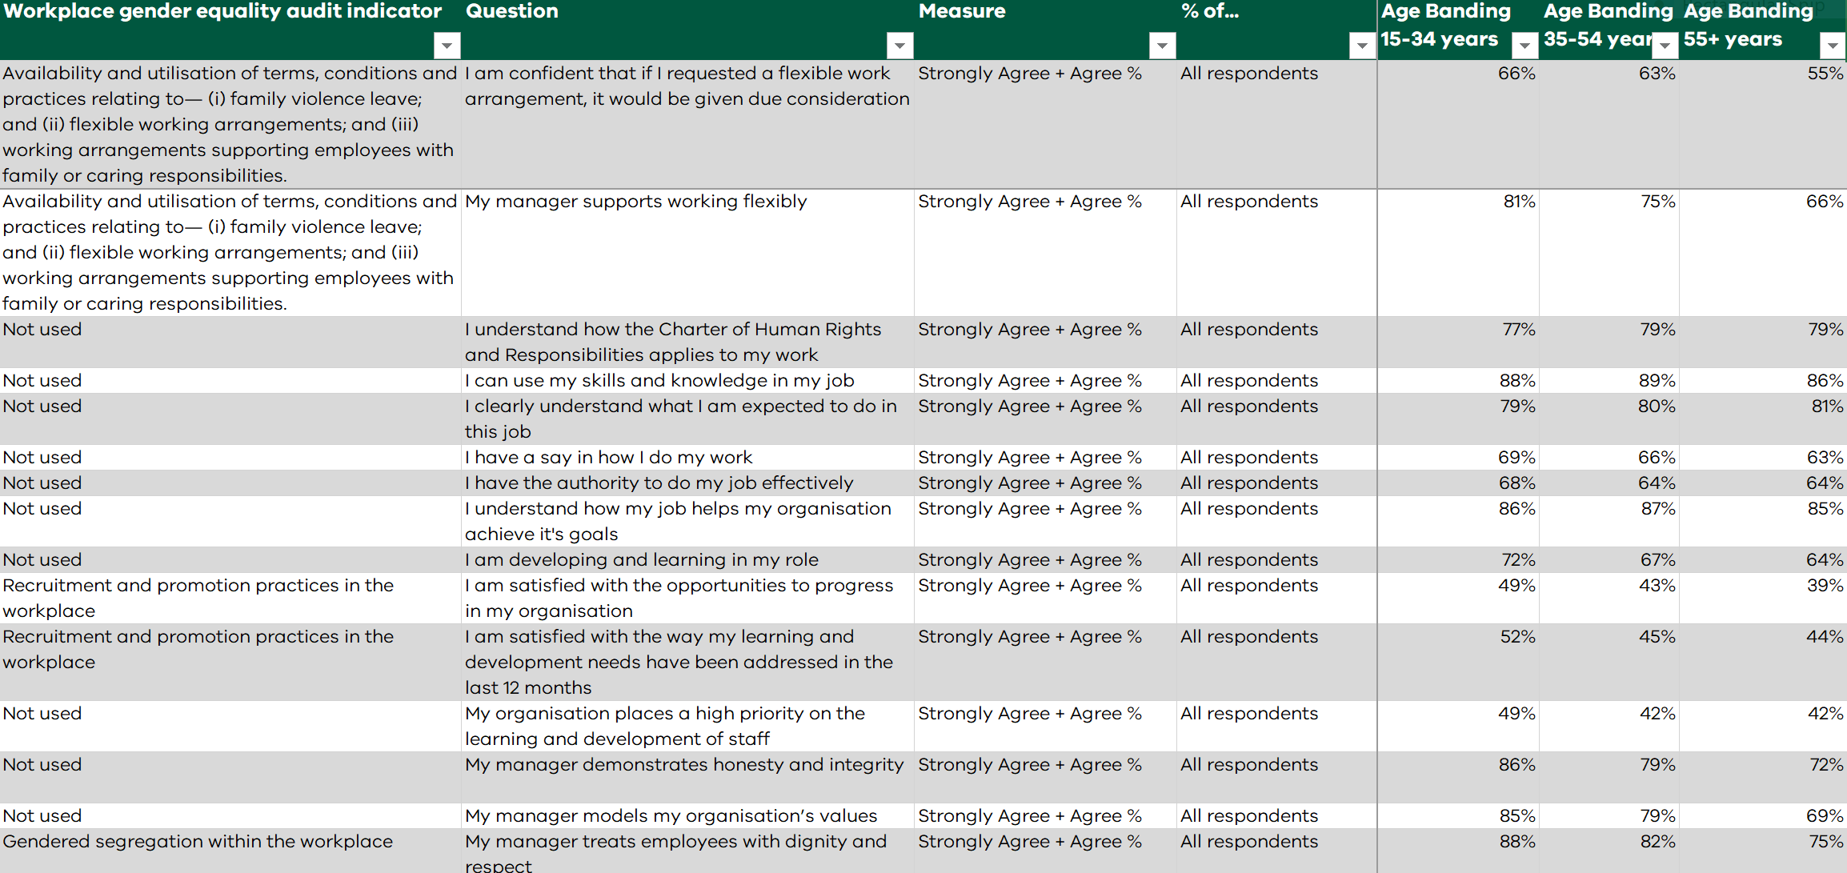
Demographic matrix Excel file
Demographic matrix file which shows:
Question
Measure type
% of respondents
Each demographic group
‘Agree’ combines your staff’s responses of ‘agree’ and ‘strongly agree’.
‘Satisfied’ combines your staff’s responses of ‘satisfied’ and ‘very satisfied’.

Slide 27
Privacy and anonymity
How we protect your privacy and anonymity
To protect your anonymity and ensure people can't identify you in this reporting, we:
de-identify all data that employers get
de-identify individual survey responses. This means that organisations can't identify individuals when the data is reported
don't collect identifying information such as name, date of birth or employee ID
separate open-text responses from data that will identify you – your organisation won't know you made the comments.
In addition, if we get:
fewer than 10 responses for teams or demographic groups, we don't release employee experience results. For example, a demographic group is 'men in the same salary range' or 'women aged 40 to 49'. An experience result is '90% of women aged 40 to 49 agreed their manager supports them'.
fewer than 30 responses from your whole organisation, we don't give a breakdown by any demographic group of how many people did the survey.
Read more in our privacy policy.

Slide 28
Find out more
Find information and resources at:
https://vpsc.vic.gov.au/data-and-research/about-the-people-matter-survey/
Find 2023 survey results at:
https://vpsc.vic.gov.au/workforce-data-state-of-the-public-sector/
Contact us:
people.matter@vpsc.vic.gov.au

Slide 29
End of presentation

