Slide 1
People matter survey 2024 results
Using and understanding your results dashboards

Slide 2
Introduction
Your People matter survey results are available as online interactive dashboards,
as well as static reports in PDF, Word and Excel.
What information your organisation gets, and the types of reports are on our website.
This presentation will help you understand:
How to access your 2024 online dashboard results.
What dashboards you have access to
How to navigate the dashboards and find results for different questions.
How to export results.
We recommend you review your dashboard results, and available filters, before allowing access to additional users outside of your human resources and diversity and inclusion teams.

Slide 3
What results you have access to

Slide 4
Your People matter survey 2024 dashboards overview
Dashboard | Minimum number of survey responses needed | Only available if you chose to add custom questions | Shows organisation hierarchy results if added to survey
2024 Response rate | 10 | - | Yes
2024 Results | 10 | - | Yes
2024 Results with diversity filters* | 30 | - | Yes
2024 Diversity profile | 30 | - | -
2024 Diversity heatmaps* | 30 | - | -
2024 Custom question results | 10 | Yes | Yes
2024 Custom question results with diversity filters | 30 | Yes | -
2024 Custom demographic heatmaps | 30 | Yes | -
*Includes results to do your Gender Equality Act 2020 progress audit.

Slide 5
Your People matter survey 2024 dashboards
2024 Response rate
Your organisation's overall response rate to the survey.
The response rates of any sub-units (employee groups, divisions or teams).
2024 Results
Your organisation's results with benchmarks, including comparisons with previous years and comparator group.
Hierarchy filter to provide results for teams with 10 or more responses (if you chose to add an organisation hierarchy your survey).
2024 Results with diversity filters
Only available if your organisation achieved over 30 responses.
Provides results for demographic groups with 10 or more responses.
Includes benchmarks.
No organisation hierarchy filter in line with privacy statement.

Slide 6
Your People matter survey 2024 dashboards
2024 Custom questions
Only available if your organisation chose to include custom opinion questions in the survey.
Separate dashboards to allow you to filter by your organisation's hierarchy or demographics.
2024 Custom questions
with diversity filters
Only available if your organisation chose to include custom opinion questions in the survey.
Separate dashboards to allow you to filter by your organisation's hierarchy or demographics.
2024 Free text comments
Only available to the head of your organisation.
Dashboard allows you to view all verbatim comments and filter by key words and topics.
Your head of organisation can request additional users to be given access to this dashboard with an email to people.matter@vpsc.vic.gov.au

Slide 7
Your People matter survey 2024 dashboards
2024 Diversity profile
Only available if your organisation achieved over 30 responses.
The demographic profile of your survey sample.
Hierarchy filter to give profile for groups with 30 or more responses.
2024 Diversity heatmaps
Only available if your organisation achieved over 30 responses.
Enables you to compare organisation-level results for demographic groups with 10 or more survey responses.
Includes results to do your Gender Equality Act 2020 progress audit.
2024 Custom demographic heatmaps
Only available if your organisation chose to include additional demographic questions in the survey.
Enables you to compare organisation level survey results for custom demographic groups with 10 or more survey responses.

Slide 8
How to access your People matter survey 2024
Qualtrics results dashboards

Slide 9
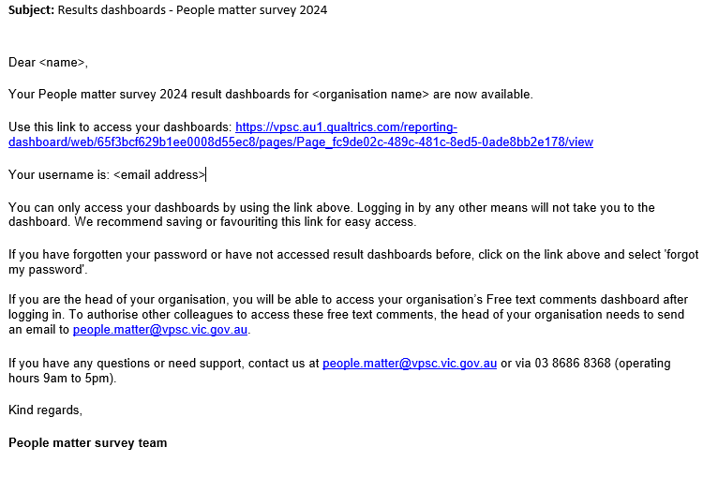
Access to your results dashboards
You should have received an email from people.matter@vpsc.vic.gov.au with a link and login details to your 2024 dashboards.
We will send the email to your:
Head of organisation.
Head of Human Resources.
Survey coordinator.

Slide 10
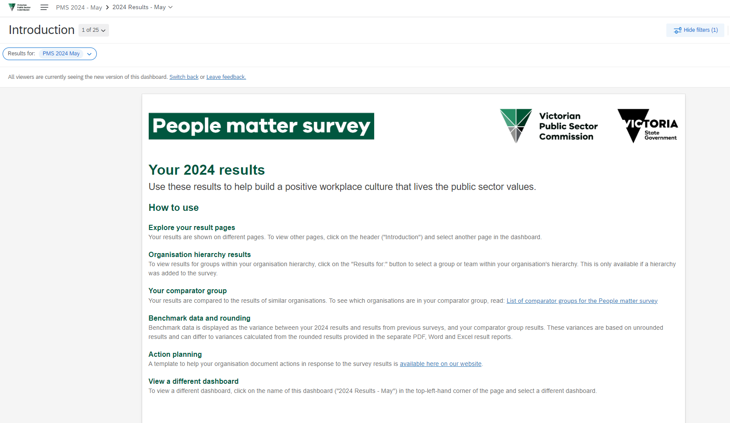
Your results dashboard
Once logged in, you will have access to a range of 2024 results dashboards.
Click on the name of the current dashboard to choose between different dashboards e.g., 2024 Results – May
Click on the page numbers to see the names of all the pages in each dashboard
Text at the top of each page explains your results

Slide 11
Your People matter survey 2024 dashboards – Access levels
Dashboard | Filters options available | Access level 1 – response rate | Access level 2 – standard results | Access level 3 – diversity results
2024 Response rate | Hierarchy | Yes | Yes | Yes
2024 Results | Hierarchy | No | Yes | Yes
2024 Results with diversity filters | Diversity | No | No | Yes
2024 Diversity profile | Hierarchy | No | No | Yes
2024 Diversity heatmaps | Diversity, Gender +1 | No | No | Yes
2024 Custom question results | Hierarchy | No | Yes | Yes
2024 Custom question results with diversity filters | Diversity | No | No | Yes
2024 Custom demographic heatmaps | None | No | No | Yes
2024 Free text comments | Topic and Key word | No | No | No

Slide 12
How to navigate your dashboards

Slide 13
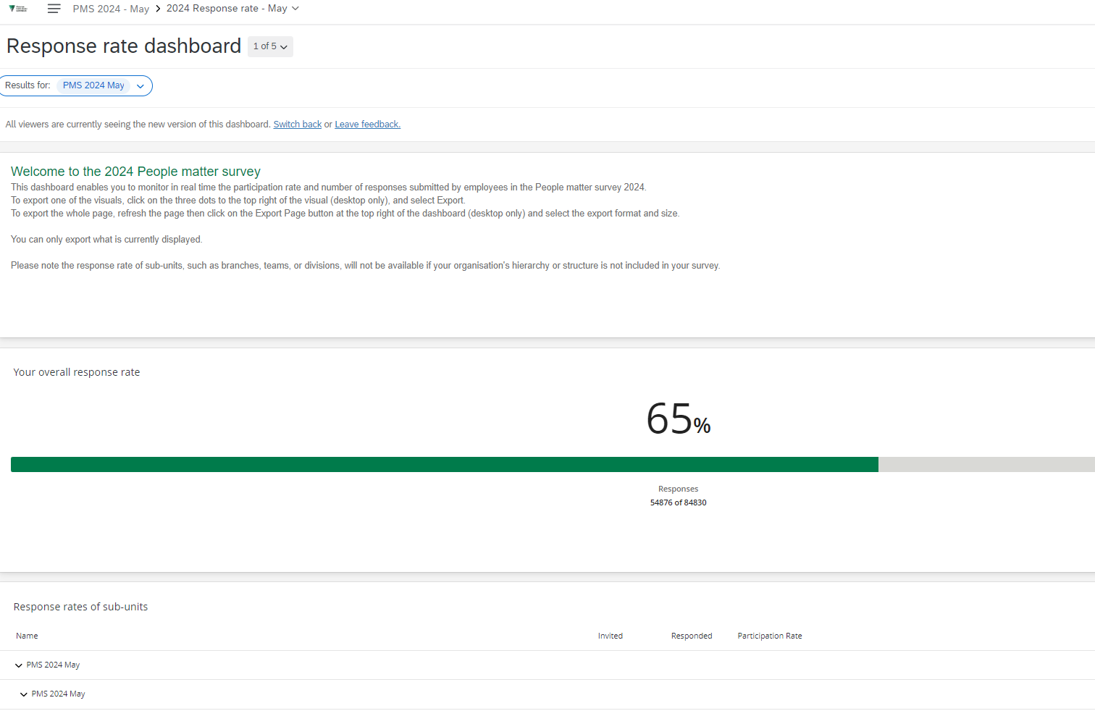
Response rate dashboard
Use the response rate dashboard to see your organisation’s overall response rate to the survey, along with the response rates of any sub-units.
Your 2024 response rate
Number of responses
Expand by clicking on each arrow
Sub-unit response rates

Slide 14
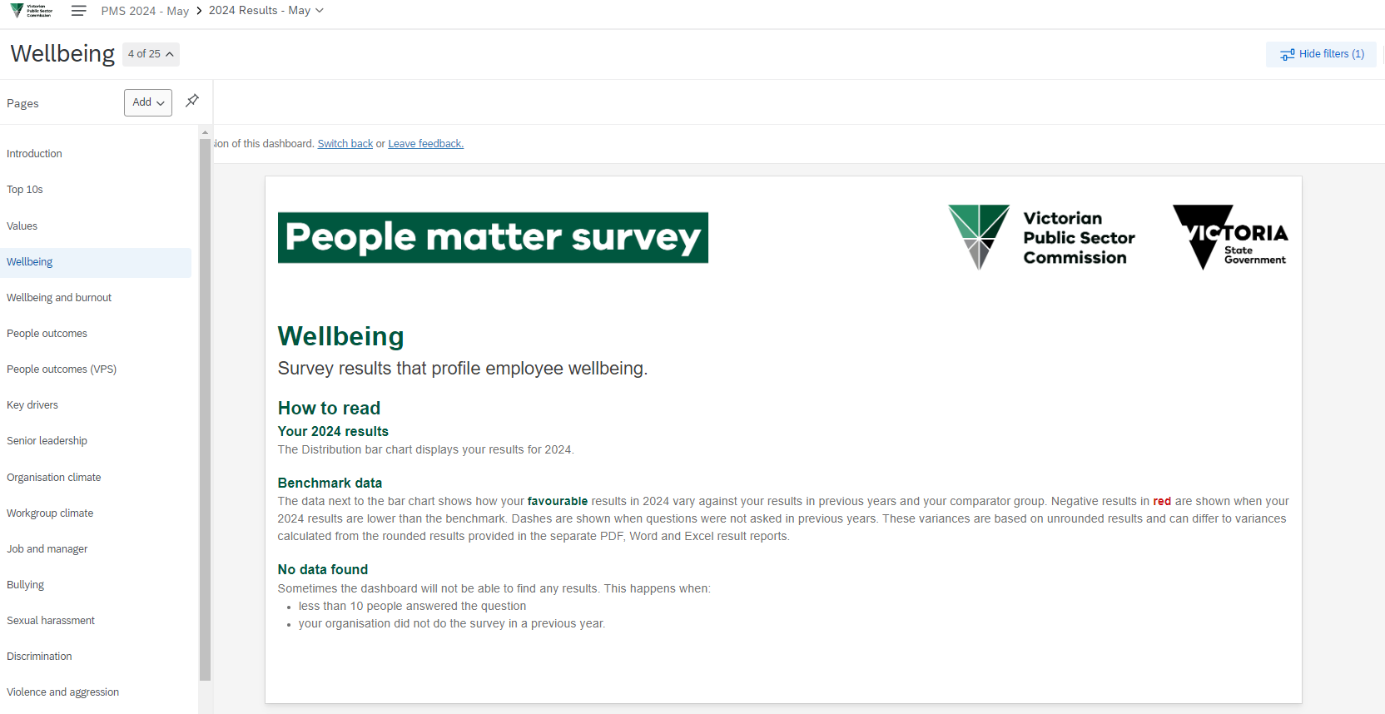
Results dashboards: overall structure
Use the results dashboards to see your organisations overall results broken down by People matter survey result topics.
Results are split across several pages which can be viewed through the left-hand navigation pane.
Click on the name of the current page, e.g. Wellbeing, to open the navigation pane.
Results pages

Slide 15
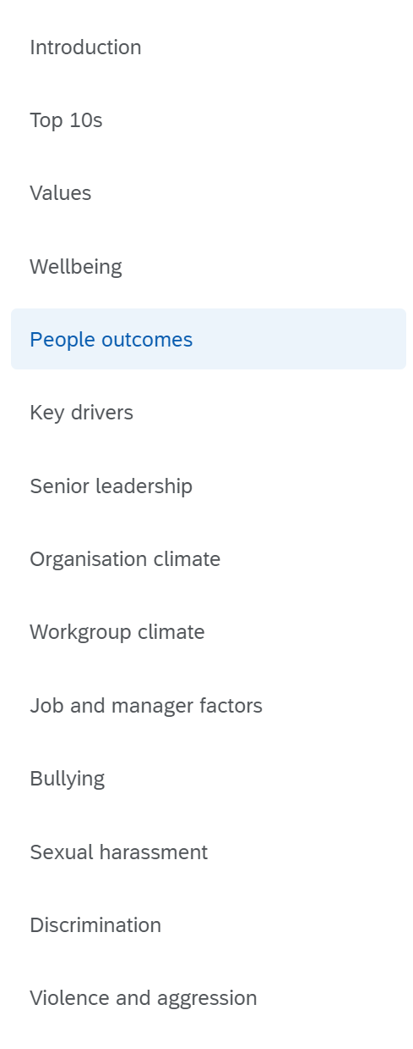
Results dashboards: result topics
Finding ‘agreement’ and ‘satisfaction’ results
All agreement and satisfaction questions can be found under their respective result topic:
Top 10s
Values
Wellbeing
People outcomes
Key drivers
Senior leadership
Organisation climate
Workgroup climate
Job and manager factors

Slide 16
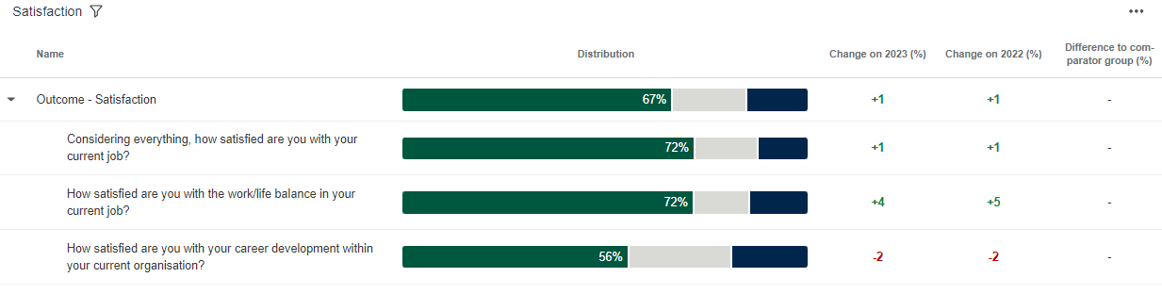
Results dashboards
Understanding ‘agreement’ and ‘satisfaction’ results
All agreement and satisfaction results show you the overall percentage of positive responses to a group of questions, as well as the percentage of positive responses to each individual question.
You can compare your results to a range of indicators.
Drill down
Overall positive response
Comparisons

Slide 17
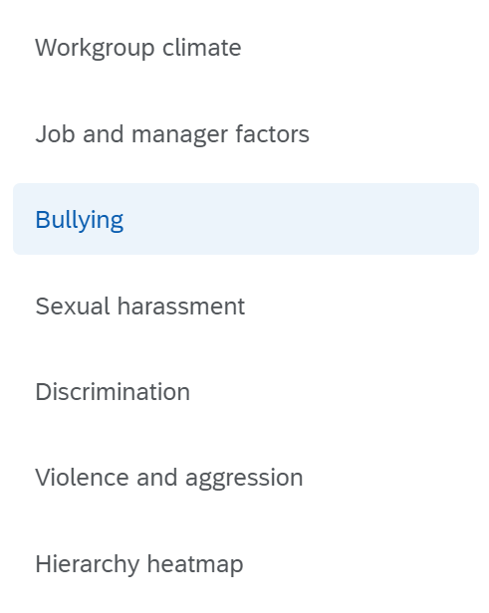
Results dashboards
Finding negative behaviour results
All negative behaviour results can be found in their respective sections on the left side:
Bullying.
Sexual harassment.
Discrimination.
Violence and aggression.

Slide 18
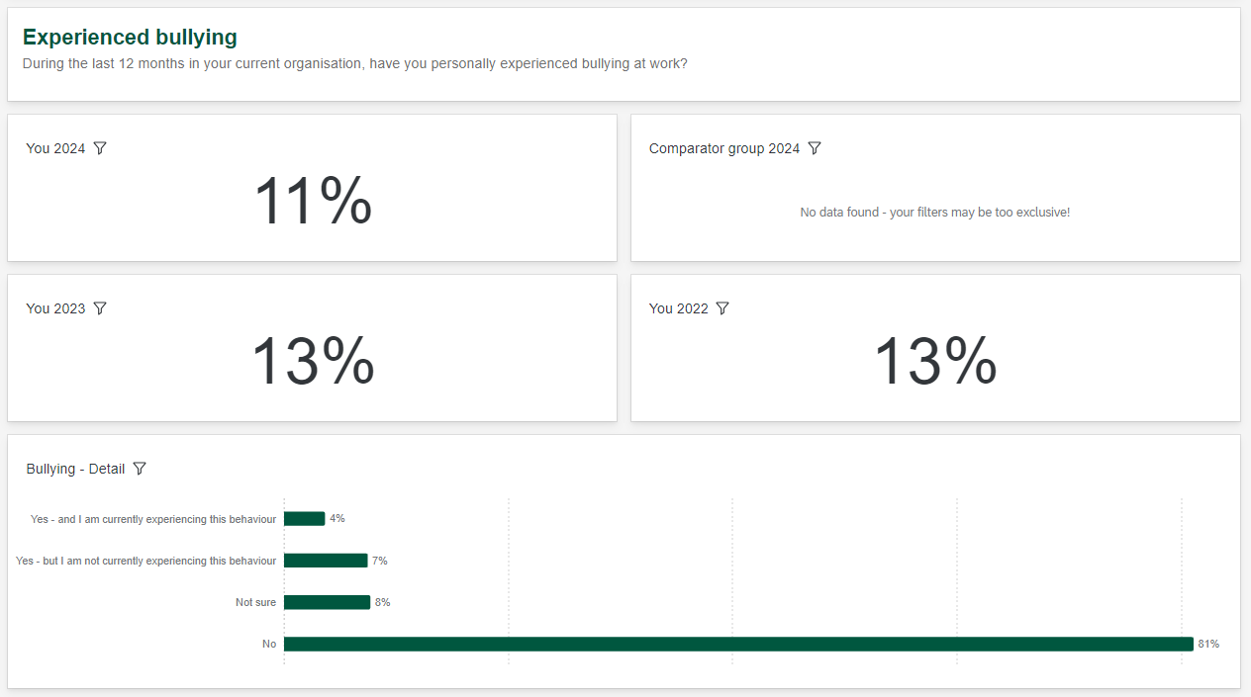
Results dashboards
Overall percentage of people experiencing
Understanding negative behaviour results
All negative behaviour results show you the overall percentage of people who experienced the behaviour, as well as a range of information on the nature of the behaviour.
This includes the type and frequency of the behaviour, as well as submission of a formal complaints.
Further information

Slide 19
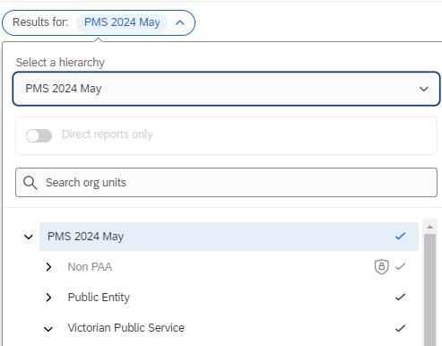
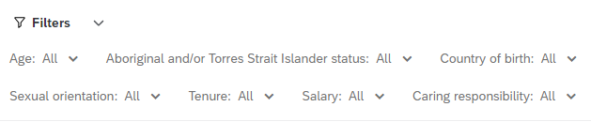
Results dashboards and diversity filters
Two separate results dashboards
2024 Results dashboard
Use the 'Results For:' filter to show results for sub-units in your organisations hierarchy
2024 Results with diversity filters dashboard
Use the filters at the top to review results for demographic groups

Slide 20
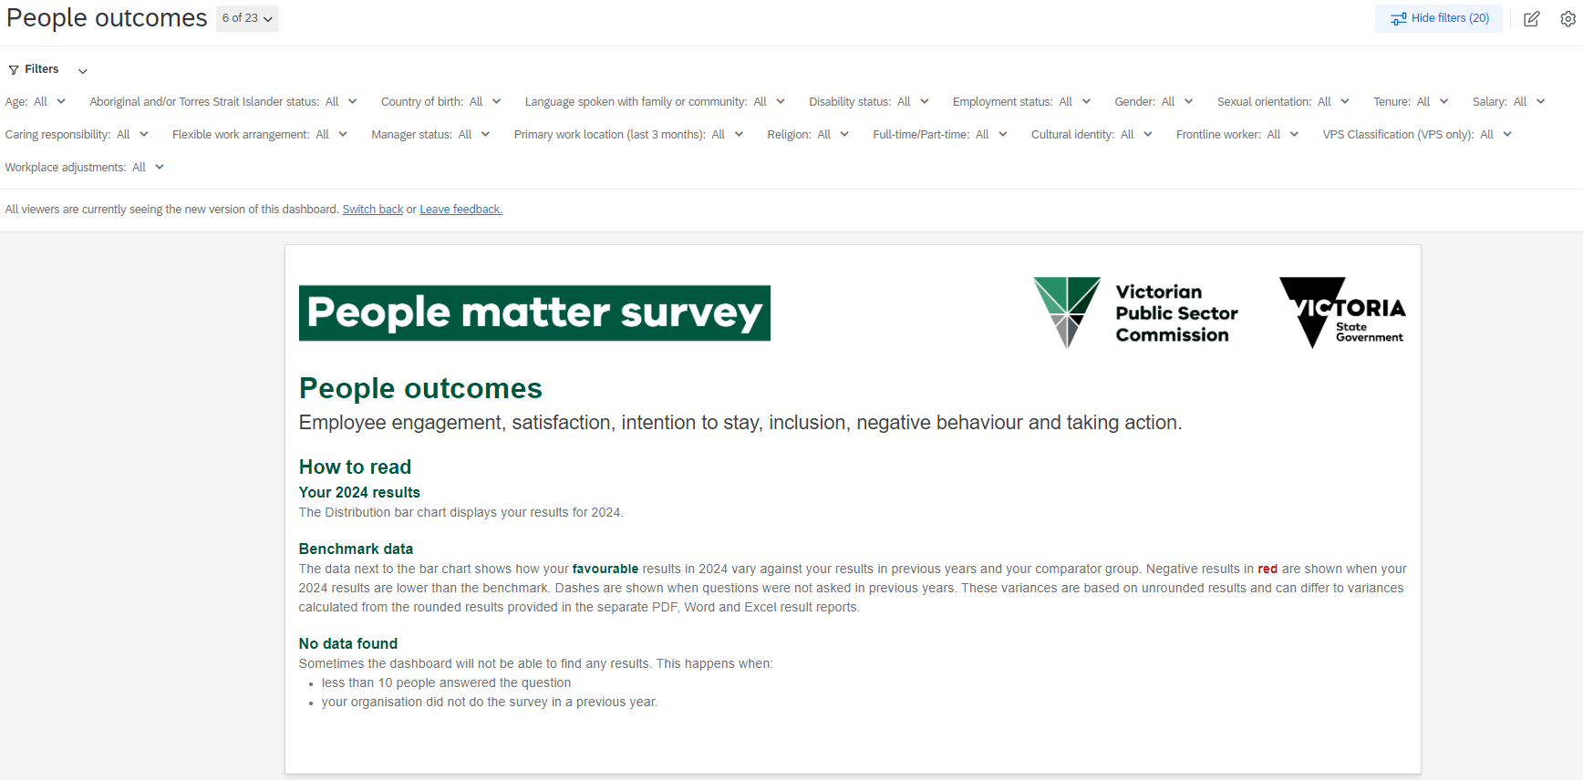
Results dashboards
Understanding anonymity in the ‘2024 Results with diversity filters’ dashboard
This dashboard allows you to filter on multiple demographics.
There is an anonymity threshold of 10. This means that if there are less than 10 responses in any demographic, results for these demographics will be grouped together for anonymity.
Tip: Use less filters if you see no results for a question.

Slide 21
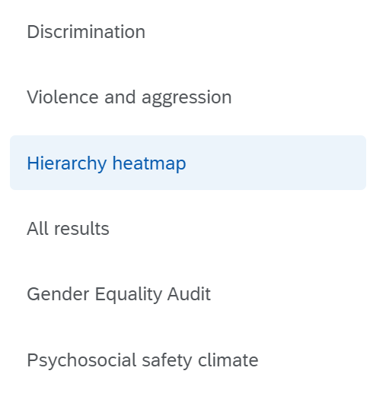
Results dashboards
Finding sub-unit (employee group) results
The results for sub-units are summarised in the Hierarchy heatmap page.

Slide 22
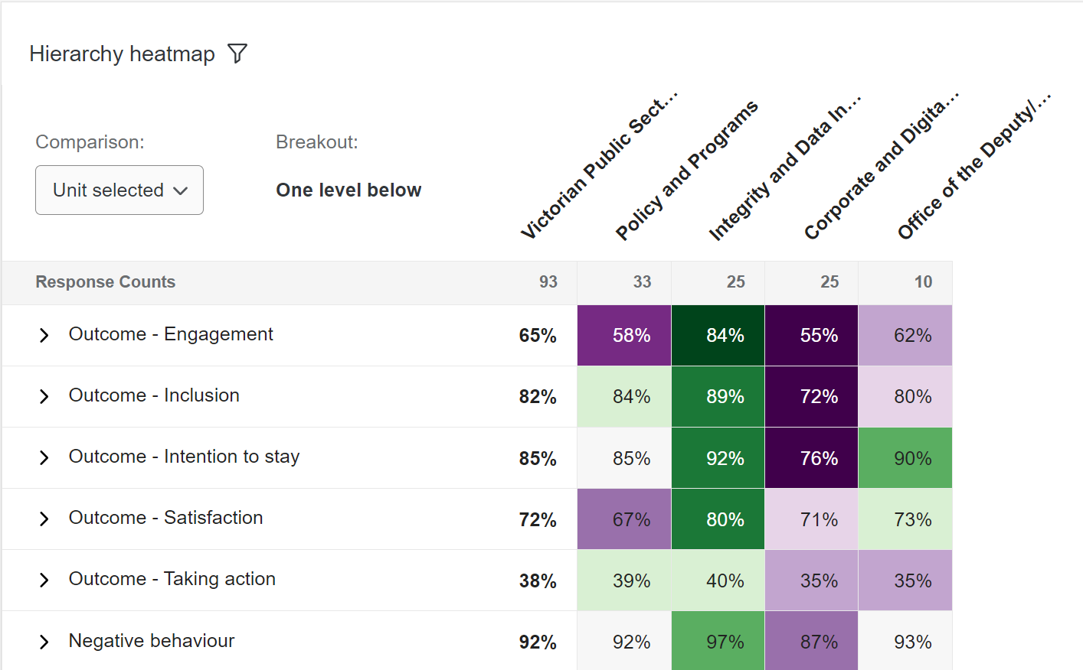
Results dashboards
Understanding the hierarchy heatmap
Overall positive response
Sub-units
The hierarchy heatmap shows you results for the group currently selected in the 'Results for:' hierarchy filter (e.g., your organisation or team) and the results of sub-units below the group selected.
All results shown are positive results.
Drill down
Click on the arrows to see questions

Slide 23
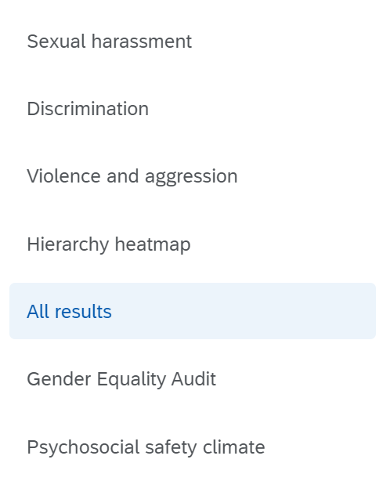
Results dashboards
Understanding All results
All results dashboard
Groups and benchmarks all questions with value scales, i.e., favourable, neutral, unfavourable
Compares your results against your previous results and your comparator group.

Slide 24
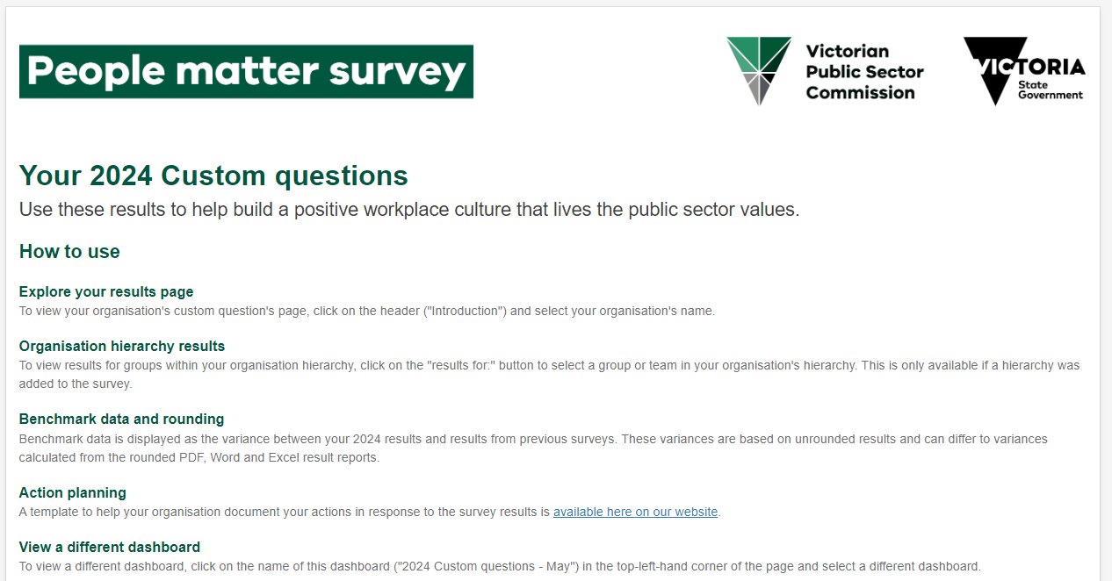
Custom questions dashboards
If your organisation asked any custom questions as part of the survey, you'll also have access to custom question dashboards.

Slide 25
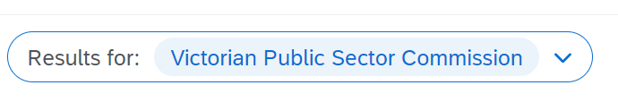
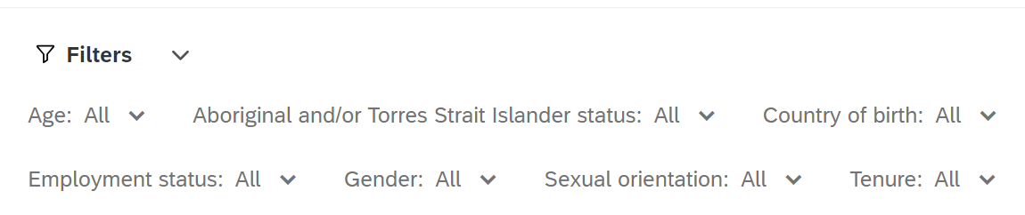
Custom questions dashboards
Two separate custom question dashboards
2024 Custom question results dashboard
Use the 'Results for:' filter to review custom question results for sub-units in your organisations hierarchy.
2024 Custom question results with diversity filters dashboard
Use the filter custom to review results for a range of demographics.
Tip: Deselect any option by clicking on it, any previous option you chose may not automatically deselect

Slide 26
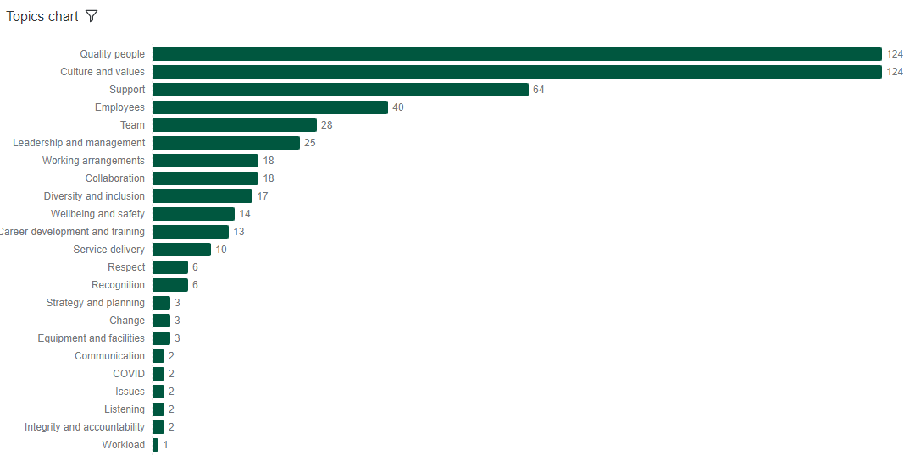

Free text comments dashboard
Verbatim free text comments can be filtered by topic and key word using the word cloud.
The verbatim responses are displayed at the bottom of the page.
Filters are displayed at the top of the page.
Access to this dashboard is only available to the head of your organisation.

Slide 27
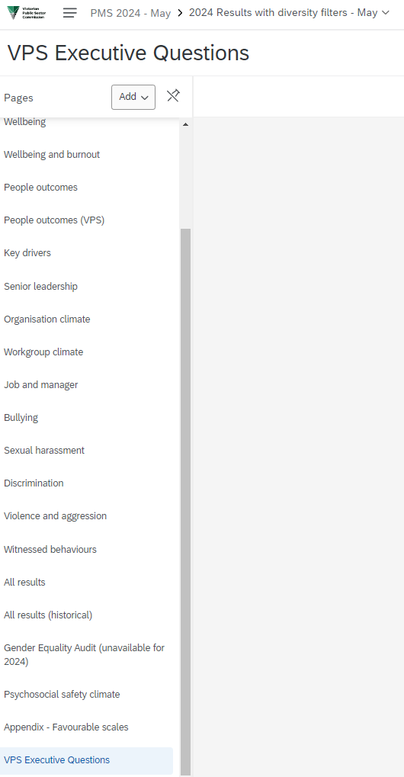
VPS executive questions (new for 2024)
This year we’ve added three questions to the survey that were only asked of executives in the VPS:
I understand my integrity obligations as a public servant
Discussions about appropriate and ethical behaviours are common in my workplace
My most recent performance management discussion had a fair balance between recognising my leadership behaviours and my delivery of results.
If you are a VPS organisation, you can access results for these questions through your interactive dashboards.
Go to the ‘2024 Result with Diversity filters dashboard’
Please note that we have restricted access to these results to Department secretaries, corporate deputy secretaries and survey coordinators only.
Find the ‘VPS Executive Questions’ page

Slide 28
How to export your results

Slide 29
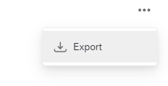
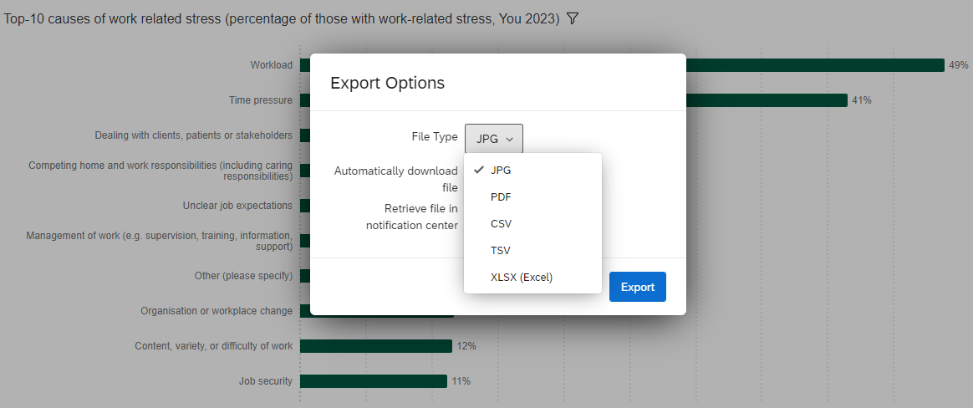
Exporting individual graphs / images
You can download any of the individual chart or visualisations in the dashboard into a range of formats, including JPG, PDF, CSV, TSV and Excel.
To access the Export function:
move your pointer to the top right corner of the box that contains the chart
three dots will appear
click on the three dots.

Slide 30
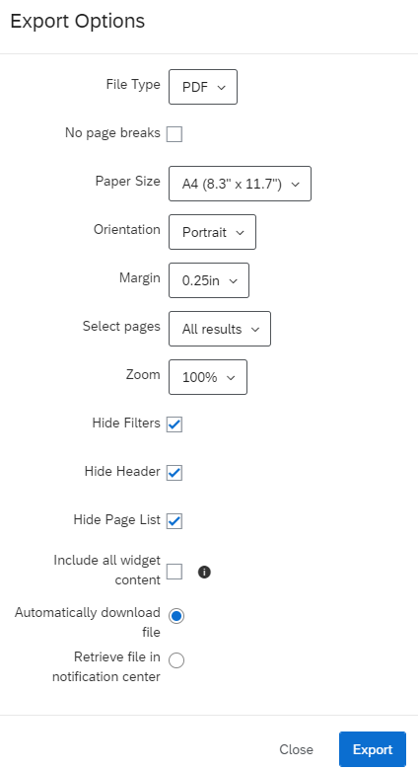
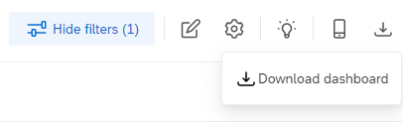
Exporting pages
You also have the option to export your dashboard pages into PDF, JPG, PPT and DOC formats.
You will find the export page functionality in the top right of each page of the dashboard.
Select file type
Customise the size
Select one or all pages
Select 'Automatic download' or 'Retrieve file in notification centre'
Tip: Large reports take longer to export, keep your browser open.

Slide 31

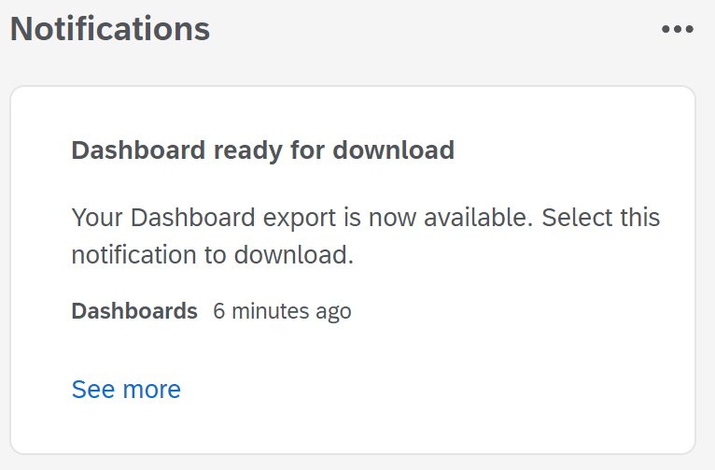
Export notifications
If you select 'Retrieve file in notification centre'
When your dashboard export is ready for download, you’ll see a notifications message at the top right of the screen.
Click on ‘See more’ in the Notifications box to download your files.
You can continue to use the dashboards while waiting for the download to complete.
Click on notifications to open your message.
Click on ‘See more’ to download your files.

Slide 32
Privacy and anonymity
How we protect your privacy and anonymity
To protect your anonymity and ensure people can't identify you in this reporting, we:
de-identify all data that employers get
de-identify individual survey responses. This means that organisations can't identify individuals when the data is reported
don't collect identifying information such as name, date of birth or employee ID
separate open-text responses from data that will identify you – your organisation won't know you made the comments.
In addition, if we get:
fewer than 10 responses for teams or demographic groups, we don't release employee experience results. For example, a demographic group is 'men in the same salary range' or 'women aged 40 to 49'. An experience result is '90% of women aged 40 to 49 agreed their manager supports them'.
fewer than 30 responses from your whole organisation, we don't give a breakdown by any demographic group of how many people did the survey.
Read more in our privacy policy.

Slide 33
Find out more
Find information and resources at:
https://vpsc.vic.gov.au/data-and-research/about-the-people-matter-survey/
Find information your organisation gets at:
https://vpsc.vic.gov.au/data-collection/about-the-people-matter-survey/data-collection-statement-people-matter-survey/#heading3
Contact us:
people.matter@vpsc.vic.gov.au

Slide 34
End of presentation

